Slide 1
BARRA: A new high resolution weather data for Australia
BARRA - Bureau of Meteorology Atmospheric high-resolution Regional Reanalysis for Australia
Chun-Hsu Su, Nathan Eizenberg, Peter Steinle
Science To Services, Bureau of Meteorology
ACCESS Science Day 2, CSIRO, 24 May 2019
Notes:
Good morning. Thank you for having me to provide an overview of a new climate data set BARRA, produced using ACCESS.

Slide 2









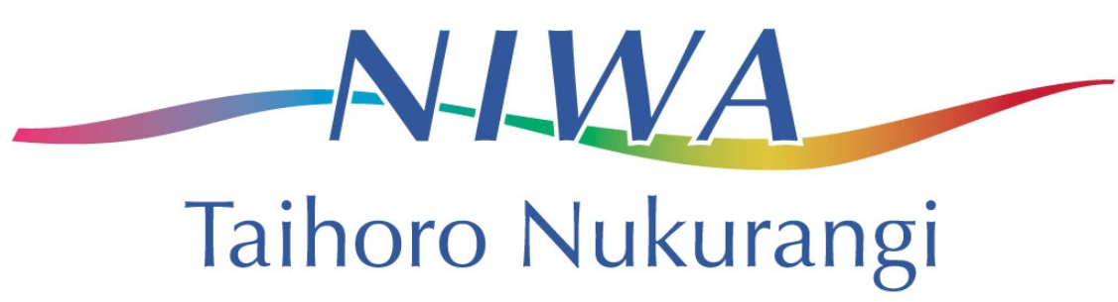

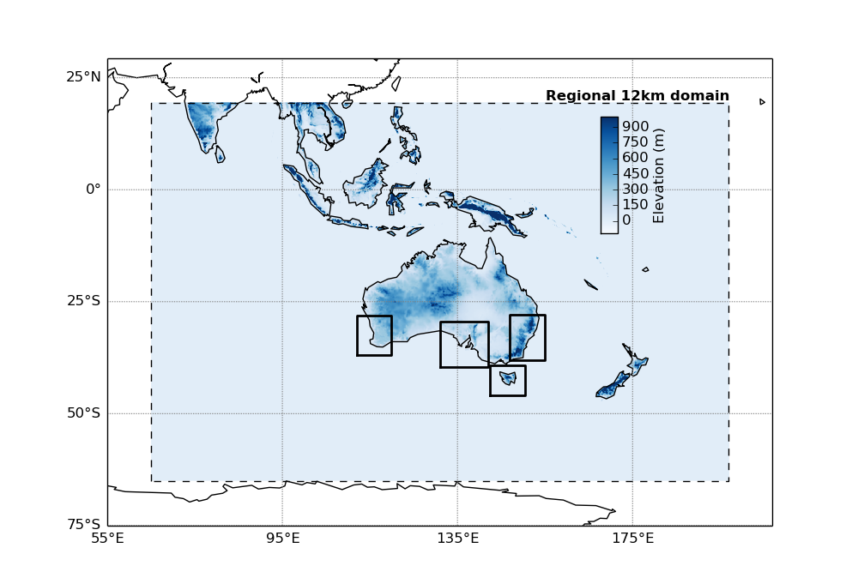
5 domains:
BARRA-R (12 km)
BARRA-SY (1.5 km)
BARRA-TA (1.5 km)
BARRA-AD (1.5 km)
BARRA-PH (1.5 km)
Time period – 29.17 years:
Jan 1990–Feb 2019
Follows ACCESS NWP,
UKMO reanalysis (UERRA),
Indian reanalysis (IMDAA)
Production completed
BARRA-R
BARRA-PH
BARRA-SY
BARRA-AD
BARRA-TA
Notes:
A summary of the BARRA
BARRA is a merged model and observation data sets.
The data exists for 5 domains, at two different resolutions.
BARRA-R is a 12 km model over the entire domain, and 4 other smaller domains centred at Perth, Adelaide, Sydney and Tasmania are of 1.5km resolution.
Each of the subdomains is set up to support the planning work undertaken at the state fire and emergencies agencies.
The data spans over just over 29 years, going back to 1990.
The method to produce this data set follows closely with ACCESS NWP, and the regional reanalysis work undertaken by UK and Indian Met Services.

Slide 3
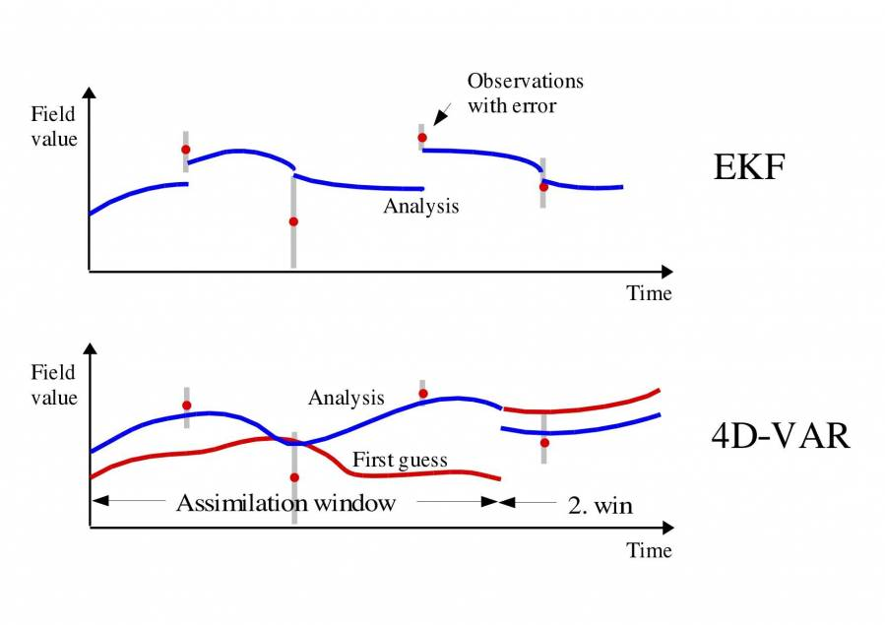
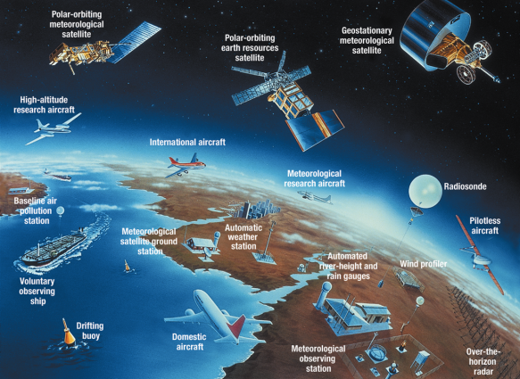
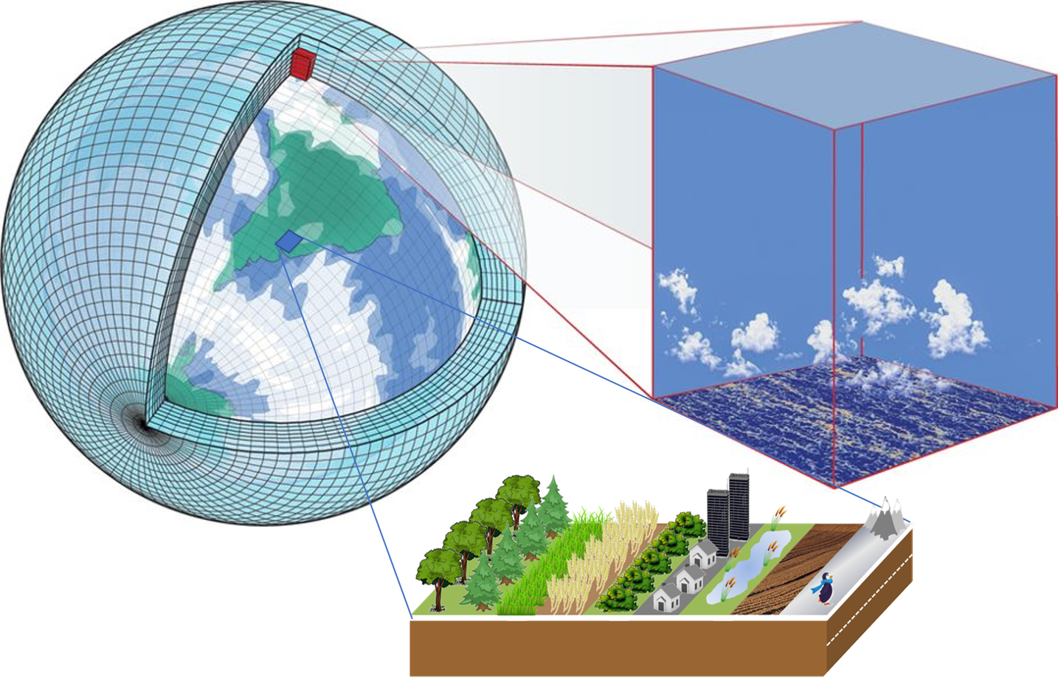
Data assimilation – 4DVar: Drawing model closer to observations
DA: Driving with your eyes closed. Open eyes every 10 seconds and correct trajectory
– O'Neill
time
+
ACCESS
(UKMO Unified Model,
JULES)
Notes:
BARRA performs analysis on the observations using the ACCESS model using 4-dimensional variational analysis.
The model is adjusted to best match the observations spread over the analysis window.

Slide 4
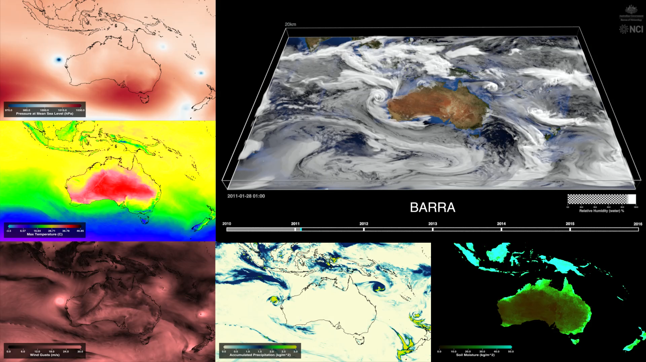
* Drew Whitehouse, ANU/NCI
https://youtu.be/bBLsn_WCg8g for 6-year time lapse
MSLP
Relative humidity
2m T
Wind gust
Precip
Soil moisture

Slide 5
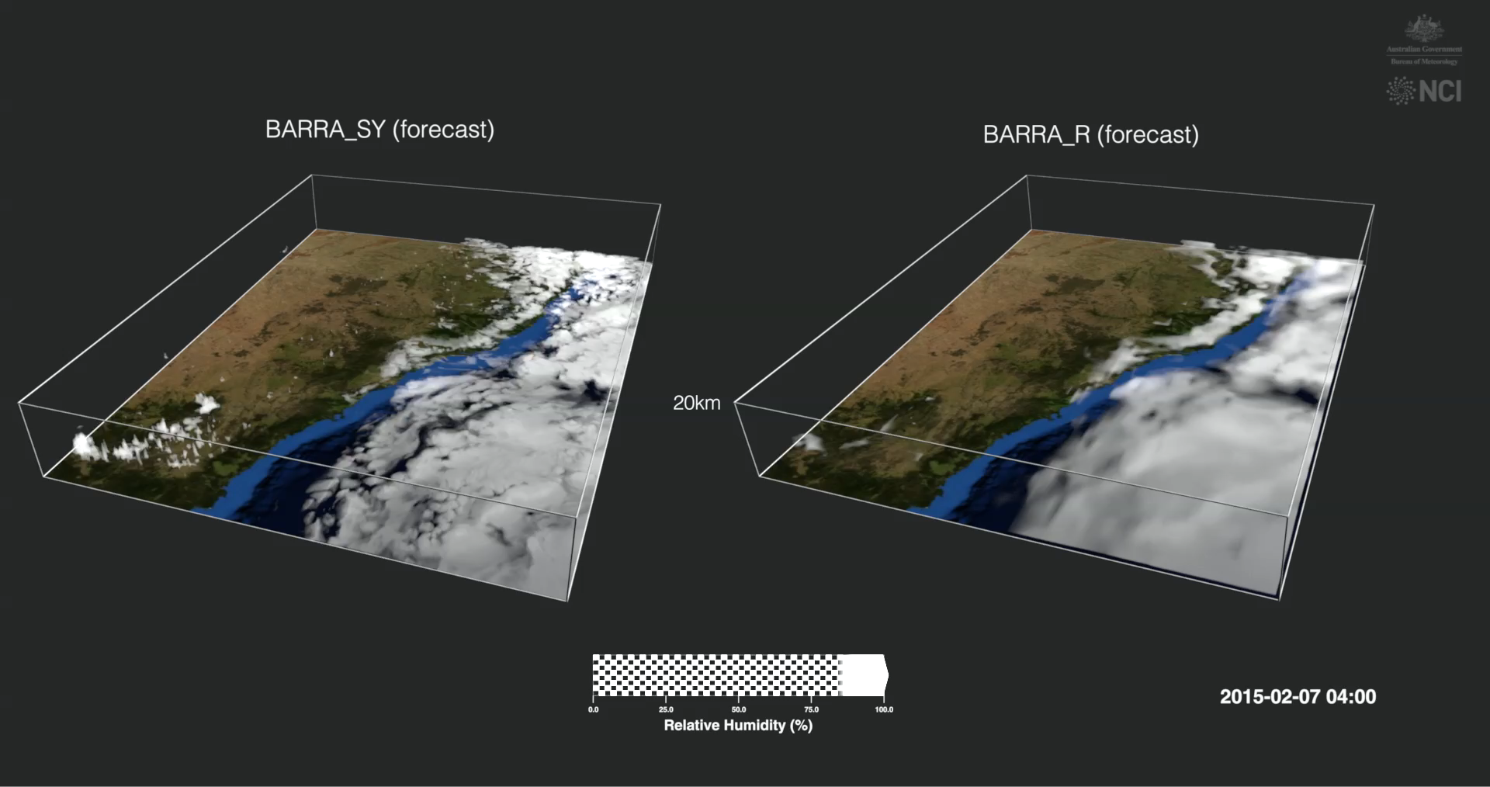
* Drew Whitehouse, ANU/NCI

Slide 6
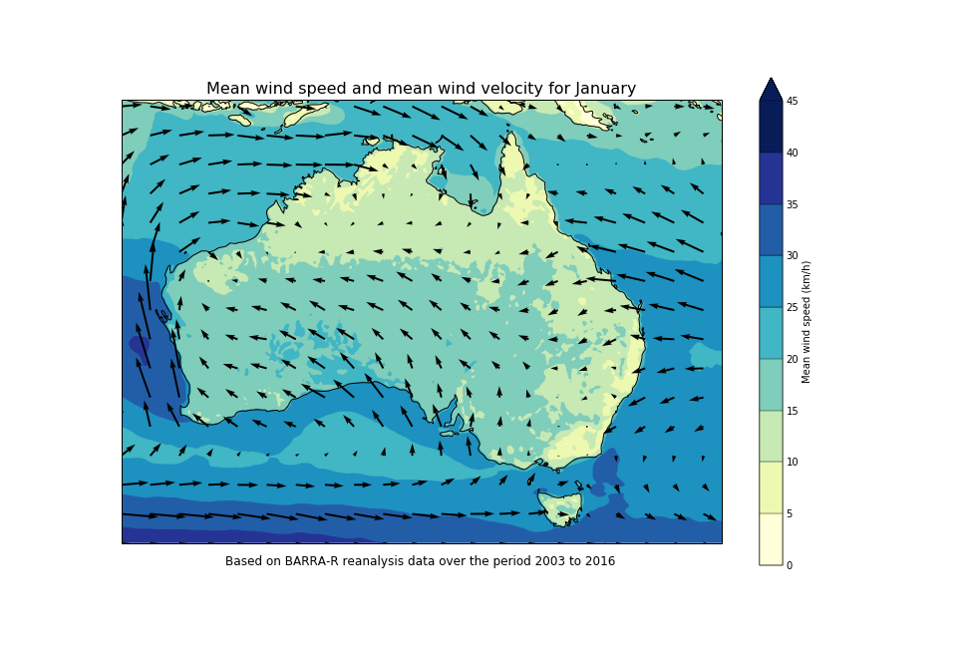
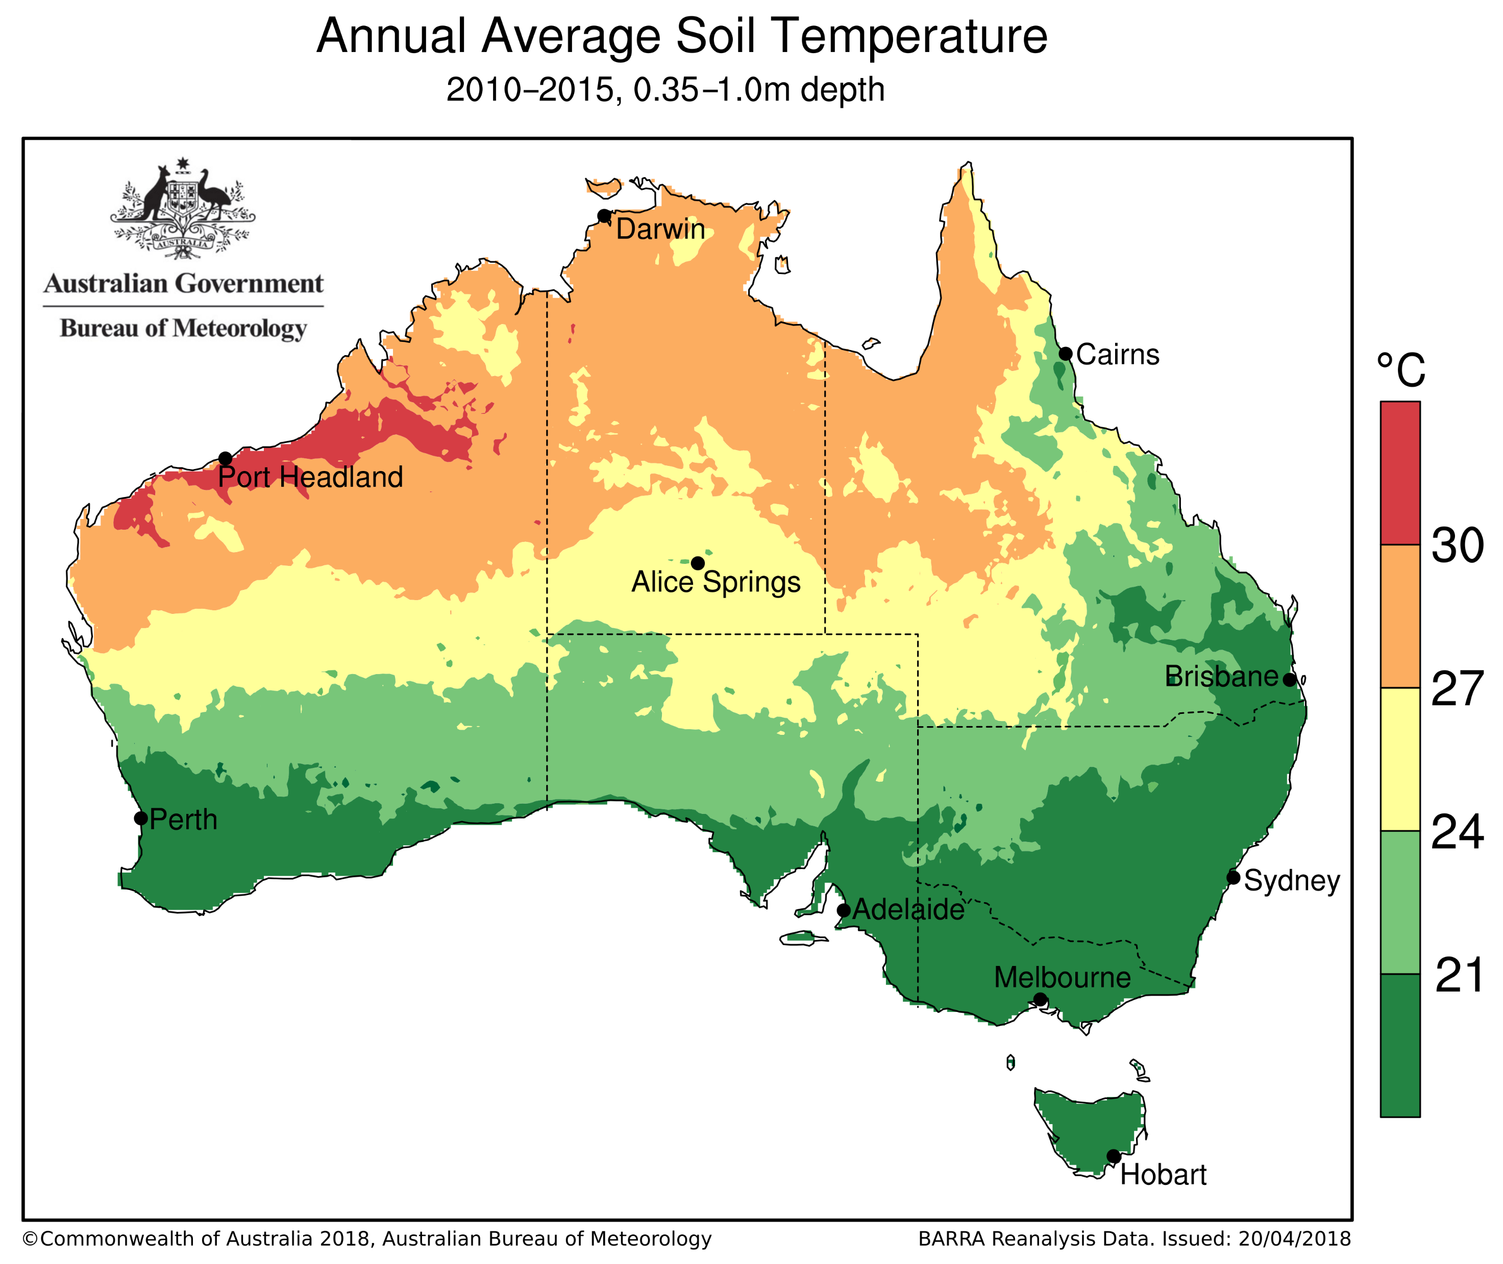
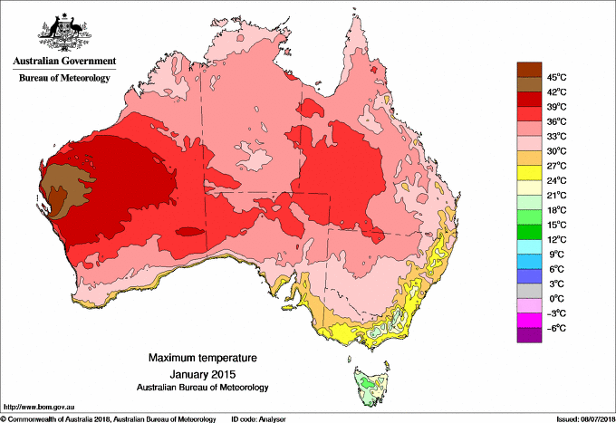
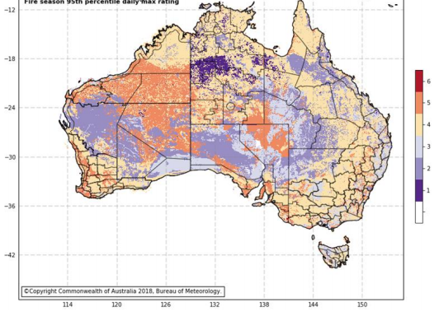
Example applications and uses
Reanalysis derived climatology for 10 m wind, soil temperature (M Black, R Taggart (BOM))
Climate analysis products (R Fawcett, R Smalley, BOM)
National Fire Danger Ratings System prototype (S Matthews (RFS), P Fox-Hughes, S Sauvage (BOM))
Evaluation of fire spread simulators (S Matthews et al., NSW RFS)
Gap identification for observation network for fire risk monitoring (M Black for NSW RFS)
Driving ocean models (F Colberg (BOM))
Study of damaging wind in SA (A Dowdy (BOM))
Air force mission planning (DST)
Risk assessment for the energy sector (AEMO)
Research users in diverse areas (water & air quality, renewables, land monitoring, hydrology, marine, bushfires): 50+ external (e.g., universities, CSIRO, MDBA) and 30+ internal users.
Wind climatology
Soil temp climatology
AWAP with BARRA
as first guess
95th percentile NFDRS
In Development
In Development

Slide 7

Getting access to BARRA on NCI
Model level parameters 'mdl'
On 70 model levels
12 params
U & V winds, pressure, temp, specific humidity, vertical wind, …
More info on getting access through external webpage http://www.bom.gov.au/research/projects/reanalysis/
Email BARRA
helpdesk.reanalysis@bom.gov.au
No license required for research use
Su et al. (2018), BARRA v1.0, https://www.geosci-model-dev-discuss.net/gmd-2018-277/
Cloud parameters 'cld'
On 70 model levels
8 params
rain, number cloud droplets, area_cld_frac
1 h
Pressure level parameters 'prs'
On 37 pressure levels
8 params
U & V winds, pressure, temp, relative humidity, potential vorticity, …
Single level parameters 'slv'
Fluxes, surface, tiles, soil levels
63 params
Soil moisture, Ave. total cloud, Ave. net longwave radiation, visibility, …
High-frequency parameters 'Spec'
Single level at surface or on tiles
33 params
Accum. precipitation, tiles potential evap., temp, number of lightning flashes, …
10 m

